Slide 1
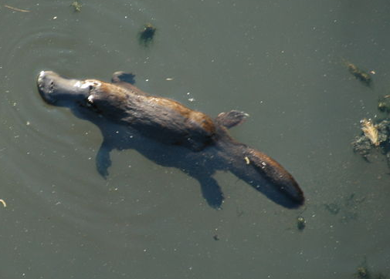
The Platypus

Slide 2
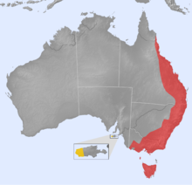
Platypus range
(red — native, yellow — introduced)

